Slide 1

CSSD 111: Introduction to Computer Systems
Week 1: Introduction to the World of Technology
Lecturer: Mutala Mohammed
Department of Computer Science
Faculty of Computing and Information Systems
Academic Year: 2025/2026.

Slide 2
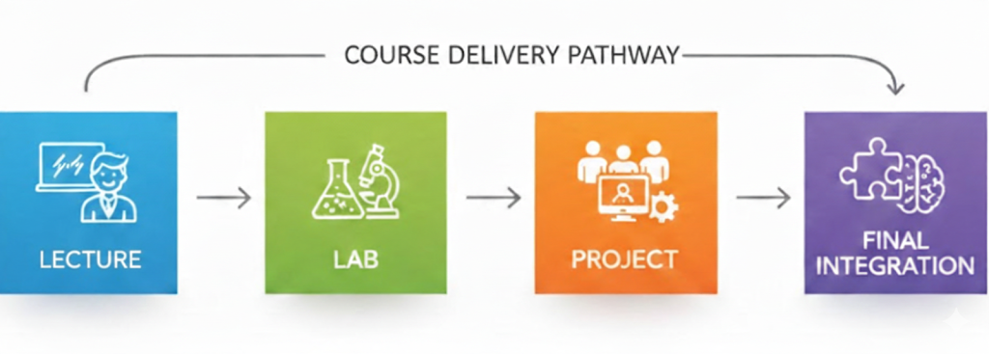
Course Overview (Brief Reminder)
Course structure (2h Lecture + 1h Lab)
Cumulative Enterprise Project introduction
Assessment structure overview

Slide 3

Learning Objectives
By the end of this week, students should be able to:
Why study Computer systems?
Define data, information, information, system
Explain what a computer system is
Identify major categories of computing devices
Distinguish personal computing from enterprise computing
Organize digital files professionally for lab and integrated project work.

Slide 4
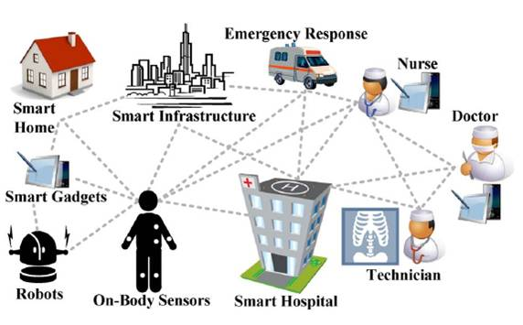
• Why study/impact computer systems?
The transition from "computer literacy" to "digital fluency“
Ubiquitous Computing (now Computers are Everywhere)
Impact of computer on almost all Professional Careers
Efficient Data Management.

Slide 5
The Ubiquity of Computers
Ubiquitous Computing:
Computers are everywhere—in our pockets, cars, and appliances.
The Shift (in our case):
We are moving from "computer literacy" (knowing how to use a PC) to "digital fluency" (using technology to solve organizational problems).
Application:
Specific major professions (Marketing, Finance, HR) require we study its own specific systems.

Slide 6
• Why study/impact computer systems?
Area | Impact
Productivity | Systems automate repetitive tasks, allowing humans to focus on creative problem-solving.
Communication | Global connectivity allows for real-time collaboration across different time zones.
Decision Making | Real-time data processing provides managers with accurate insights to make better business choices.
Security | Understanding systems is the first step in protecting personal and corporate data from cyber threats.
SO, IT’S NOW A MUST WE STUDY COMPUTER SYSTEMS

Slide 7
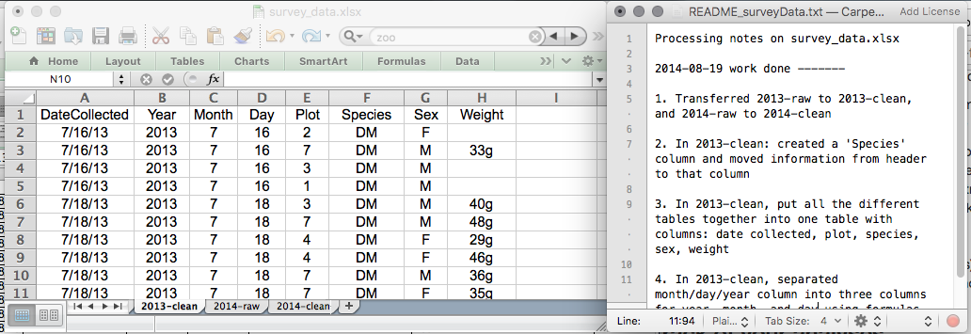
From Data to Information to Knowledge
What is Data?
Definition: Data = Raw, unprocessed facts.
Examples:
25 old
“Accra“
23°C
0244018812

Slide 8
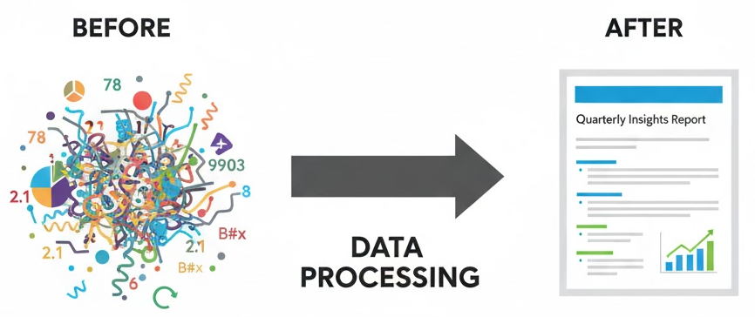
From Data to Information to Knowledge
What is Information?
Information = Processed data that has meaning.
Example:
“Total sales this month: GHS 45,000”
“Temperature is 23°C — cool weather.”

Slide 9
From Data to Information to Knowledge
Data vs Information (Comparison)
Data | Information
Raw | Processed
No meaning alone | Meaningful
Input | Output

Slide 10
From Data to Information to Knowledge
DIKW Pyramid (Data, Information, Knowledge, Wisdom)
Definition:
Knowledge (The Application): The ability to use information to make decisions, solve problems, or create strategies.
It is information combined with experience and understanding.
Level | Description | Example in a Business Context
Data | Raw facts | "GHS 500"
Information | Data with context | "The price of the component is GHS 500."
Knowledge | Information + Application | "GHS 500 is too expensive compared to our budget; we should find a new supplier."

Slide 11
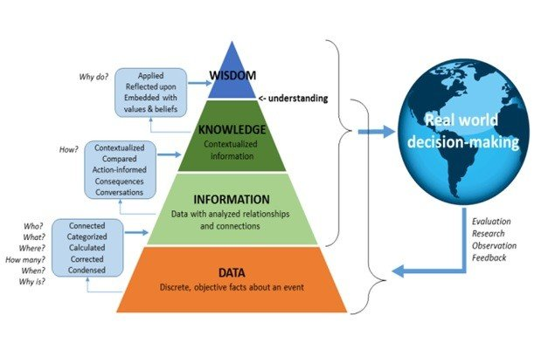
From Data to Information to Knowledge
Why: In the "Knowledge Age," the value is in using the Knowledge (e.g. car: the engine knowledge + experience by driver) to make strategic decisions.

Slide 12
Information Systems (The "System" part
What then is a System?
Back in the SHS: circulatory system, digestive system, etc.
A System:
as a combination of different components/parts/organs/people that work together to produce to produce a goal/output
The components play different roles,
but work together to achieve/towards a main goal.
What is information systems?
Information System is a combination of Hardware, Software, Data, People, and Procedures that work together to produce information.
Impact: This connects the "Computer" (hardware/software) to the "Business" (people/procedures), which is the core of Digital Fluency.

Slide 13
Foundations of the Connected World
How these systems talk to each other?
Networks
For the global system, it’s the Internet/Web
What is a Computer Network?
A collection of computers and devices
connected together so
users can
share hardware, software, and data, as well as communicate.

Slide 14
Foundations of the Connected World
The Internet vs. The World Wide Web (WWW)
The Internet:
The physical network of networks, linking billions of devices globally via a backbone infrastructure.
The World Wide Web:
One specific resource available via the Internet;
it is the collection of Web pages stored on Web servers.

Slide 15
Foundations of the Connected World
Accessing the Network:
Hardware: Network Adapter (built-in) or a Modem, etc.
Gateway: Internet Service Provider (ISP), e.g. in Ghana.
Authentication: Logon information (Username and Password) for security.

Slide 16
Foundations of the Connected World
Related Online terminologies:
Surfing and Searching the Web
Surfing
Web Browser
Hyperlinks
The Home Page
Searching
Search Sites
Search Engines
Electronic Mail (E-Mail)
Email/Web Mail
Anonymity & Privacy
Digital Ethics
Citing Sources
Plagiarism

Slide 17
What is a Computer?
All these systems depend on the computer
Definition:
A programmable, electronic device that accepts data, performs operations, produces and stores results/output.
Which is usually abbreviated as:
IPO Cycle (Input → Process → Output)
The process uses: Hardware vs. Software
Hardware is the physical "body"; Software is the "mind" or instructions.

Slide 18
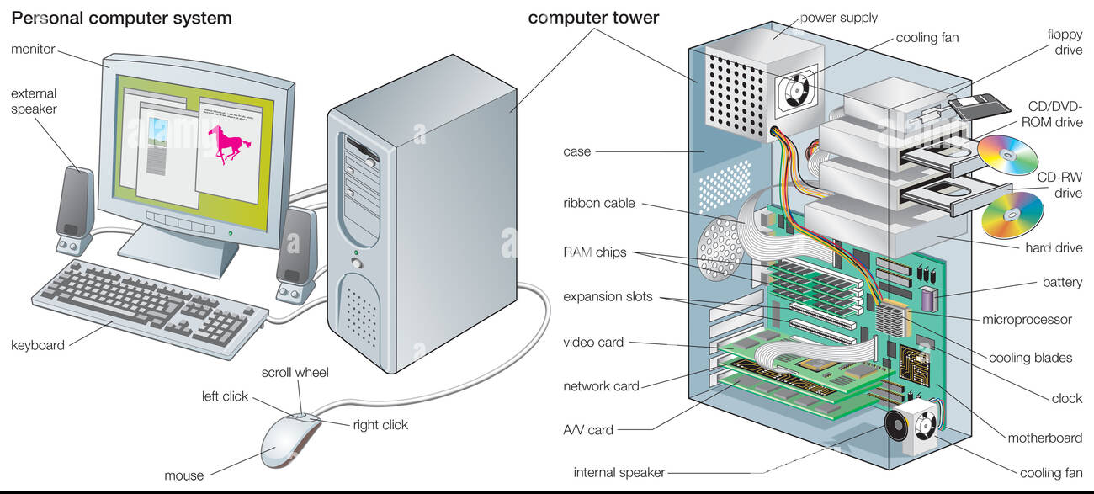
Basic Computer Components
Input Devices
Processing Unit (CPU)
Memory & Storage
Output Devices

Slide 19
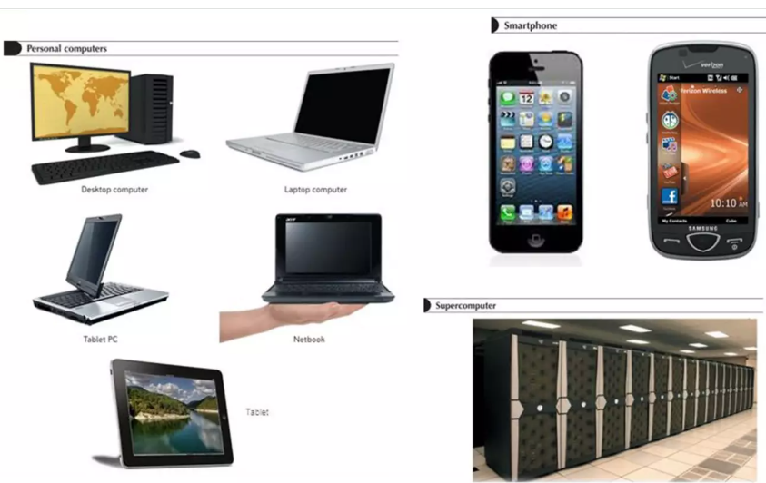
Types of Computing Devices
Desktop
Laptop
Tablet
Smartphone
Server
Embedded Systems (ATM, POS, Car systems)

Slide 20

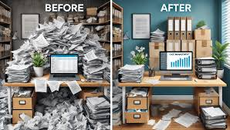

The Digital Revolution
Discuss:
From paper-based to digital
Automation of business
Cloud computing
Mobile-first economy

Slide 21
Personal vs. Enterprise Computing
Personal Computing: focuses on individual productivity, using:
Personal laptop
personal apps
Social media
Assignments
Enterprise Computing: focuses on the whole organization, using:
Servers
networked systems
Databases (like ERP or CRM)
Security systems
These connect us to our Cumulative Enterprise Project

Slide 22
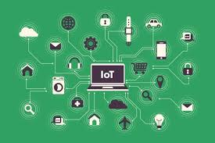
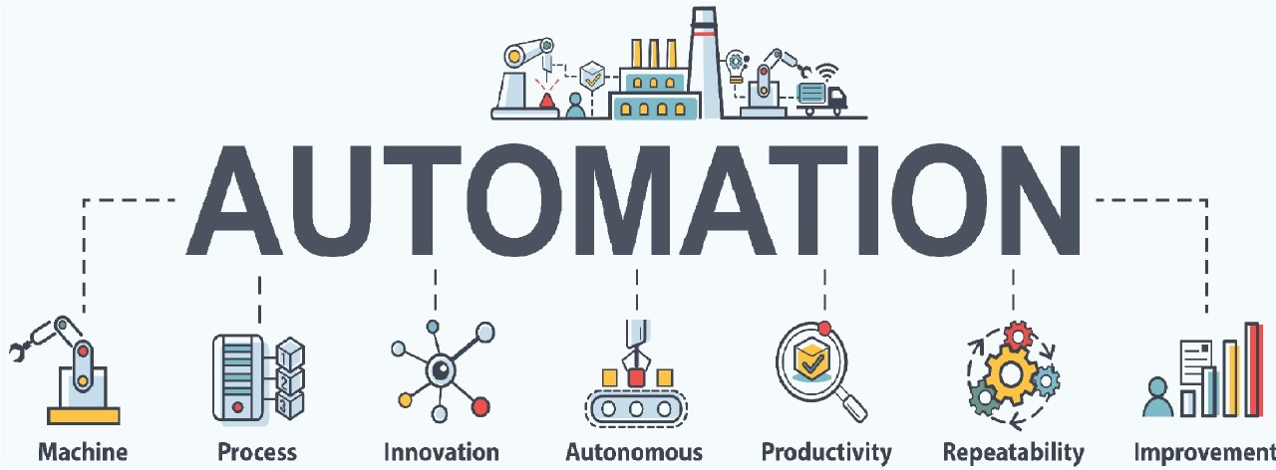
Benefits of Technology
Speed
Automation
Global communication
Data analysis

Slide 23
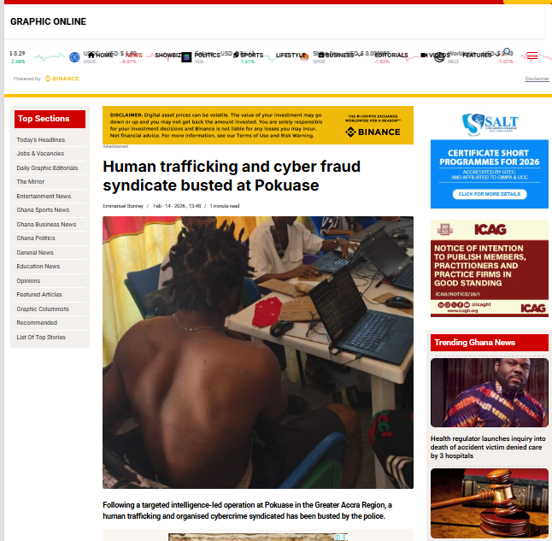
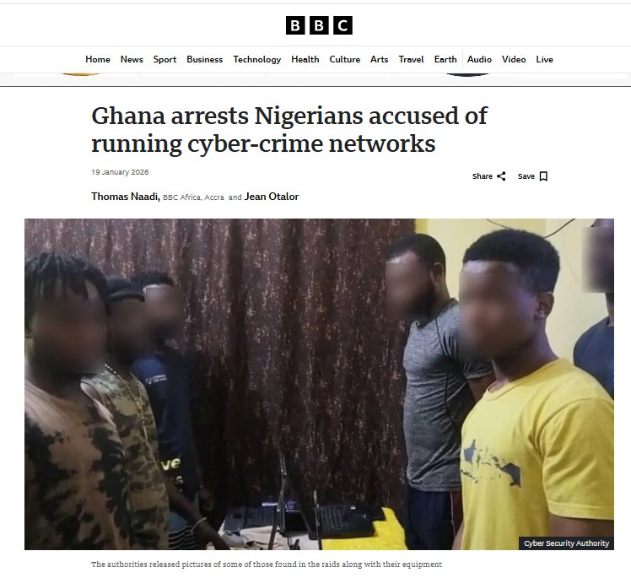
Risks of Technology
Cybercrime
Data breaches
Privacy issues
Misinformation

Slide 24


LAB SESSION

Slide 25
LAB SESSION
Operating Systems & File Management
https://www.youtube.com/watch?v=R8kXPaw-qRY
What is Software?
What is Systems Software?
Types of Systems Software
What is Operating Systems?
Examples of OS
The Purpose of OS
The Functions of OS
File Management
Files
File types, File names, File extensions, File explorers.
Folders/Directories
Hierarchical folders
File sharing
Applications Software

Slide 26
LAB SESSION
File Management
is the foundation of Data Integrity.
If you can't find the data or
if it’s named poorly,
then it can't become Information.

Slide 27
LAB SESSION
1. Define Your Business Profile
Discuss with your team and finalize the following details for your startup:
The Industry: Select a specific sector (e.g., Healthcare, Legal Services, Retail, or Creative Arts).
The Business Type: Specify the niche (e.g., a modern pharmacy, boutique law firm, or digital marketing agency).
Products/Services: Identify 3–5 core items or services your business will offer to the market.
The Business Name: Choose a professional and unique name for your startup.
The Management Structure: Assign roles to team members (e.g., General Manager, IT Manager, Operations Lead) to ensure participation and accountability throughout the 10-week schedule.

Slide 28
LAB SESSION
2. Digital Organization (Operating System Navigation)
File and Directory/Folder management
Perform the following on your lab workstation:
Create a Root Directory: Create a new folder named exactly after your Business Name.
Establish Sub-directories: Inside your main folder, create the following sub-folders to organize your work for the coming weeks:
01_Documentation (For Word reports)
02_Budget_Analysis (For Excel spreadsheets)
03_Network_Design (For Packet Tracer simulations)
04_Presentations (For the final pitch)

Slide 29
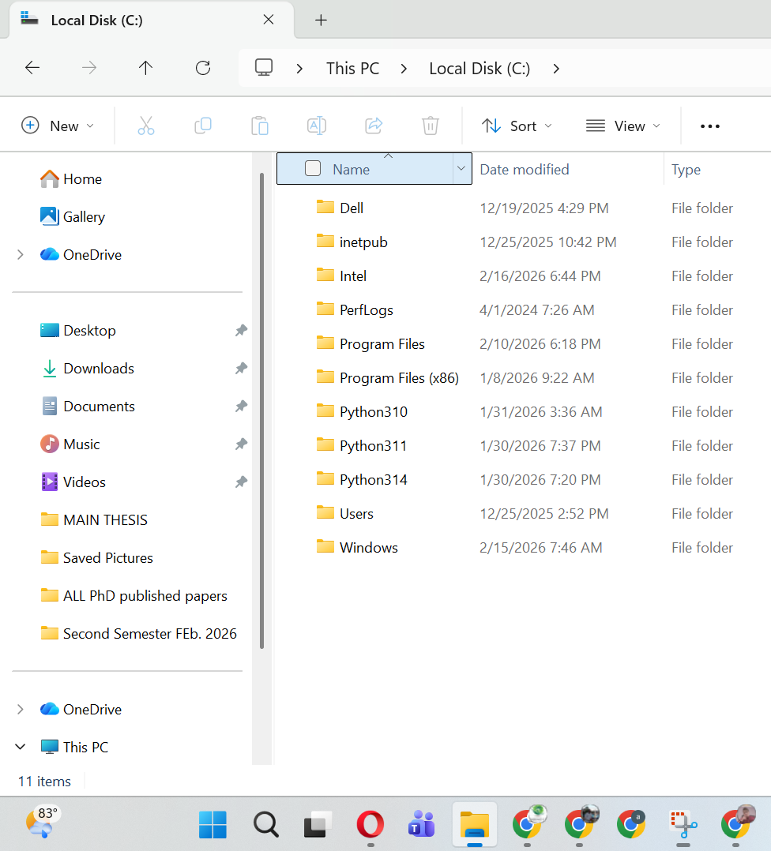
LAB SESSION
File System Hierarchy
C:\ ├── Program Files ├── Users └── Documents

Slide 30
LAB SESSION
Practical Task 1
Students prepare something similar to:
Create folder named: CSSD111_Enterprise_Project
Inside it create:
01_Documentation
02_Budget
03_Network
04_Presentation
05_Research

Slide 31
LAB SESSION
Practical Task 2
Create a file:
Executive_Summary_Draft.docx
Save it inside 01_Documentation

Slide 32
LAB SESSION
Our Checklist for Week 1
[ ] Team formed (5–6 members).
[ ] Business niche selected and approved.
[ ] Professional folder structure created on the system.
[ ] One-page "Business Profile" draft started in MS Word.

Slide 33
Reflection & Analysis Questions
The Literacy vs. Fluency Debate: Why is knowing how to use Microsoft Word or TikTok no longer enough for a business professional in the "Knowledge Age"?
DIKW in Action: You receive a notification saying "Server Temperature: 105°C." Identify which part of this is Data, which is Information, and what the resulting Knowledge (action) should be.
The Invisible System: Think of a modern ATM. Briefly identify its Hardware, Software, Data, People, and Procedures. What happens to the "System" if the Procedures are missing?
Network vs. Web: If a company’s internal server goes down, but the building still has an active fiber-optic Internet cable, why can't the employees access their internal files? (Hint: Distinguish between the Network and the Web).
Enterprise Impact: How would an Enterprise System (like a shared database) change the way a Marketing team and a Finance team work together compared to each team using their own personal laptops?
The Privacy Postcard: We discussed that E-mail is like a "postcard." List three types of business information that you should never send via standard e-mail without encryption.
Data Integrity in the Lab: Why does the Lab require a specific numbering system (e.g., 01_Documentation) for your folders? How does this professional organization impact the "Data to Information" pipeline?

